Slide 1
Cabinet Gadget
2018

Slide 2
Menu Map
Gadgets
 | Cabinets | Setup
 |  | Cabinet Style
 |  | Cabinet Dim’s

Slide 3
Setup
Name
X
Choose working directory
Choose
Job Name
Item Name
4 X 8
5 X 8
4 X 10
5 X 10
Sheet Size
Zero Position
Units
XY Position
Material Surface
inches
Machine Bed
mm
Cancel
OK

Slide 4
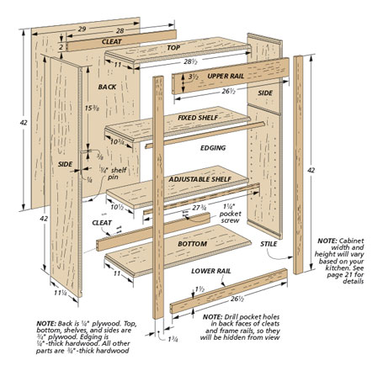
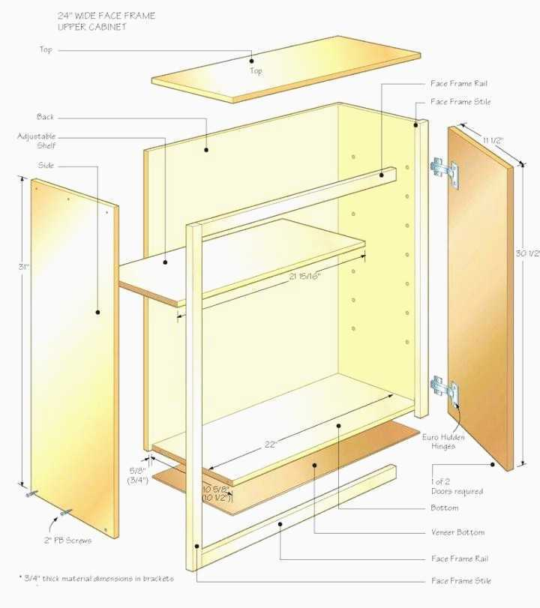
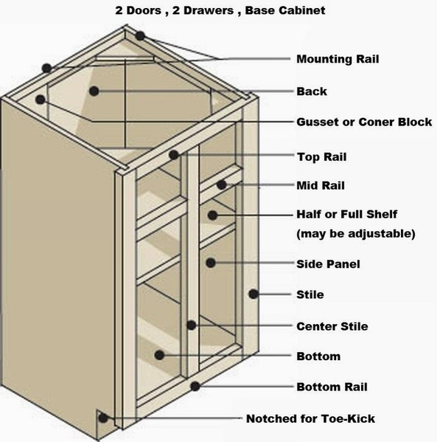
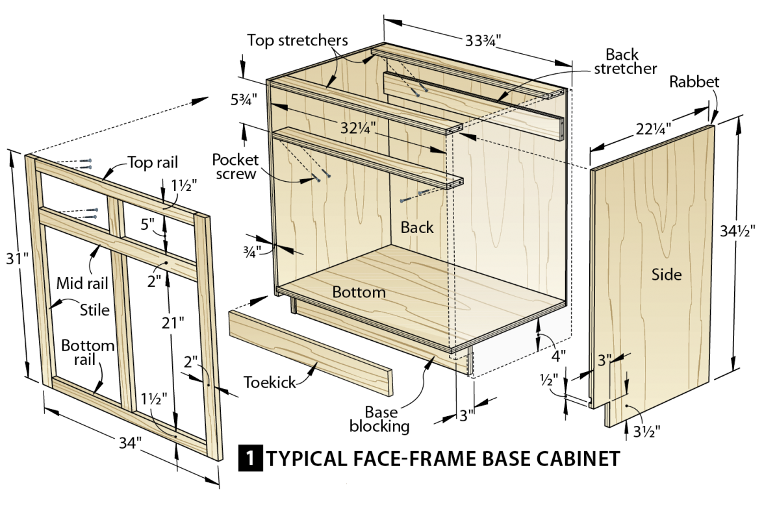
Cabinet Style
Name
X
Construction Style
Upper 1
Upper 2
American Cabinet
EMEA Cabinet
Cancel
OK
Lower 1
Lower 2

Slide 5
Upper 1
Upper 1 Cabinet Dimensions
X
Hight
Cabinet Depth
Depth
Shelf Pin Dia
Face Width
Shelf Clearance
Top Width
Machine Clearance
Bottom Width
Trim Gap
0.25
Shelf Count
Dato Depth
Face Thickness
Shelf Spacing
Back Thickness
Shelf Overhang
Side Thickness
Face Med Width
Cancel
OK

Slide 6
Upper 2
Upper 2 Cabinet Dimensions
X
Hight
Cabinet Depth
Depth
Shelf Pin Dia
Face Width
Shelf Clearance
Top Width
Machine Clearance
Bottom Width
Trim Gap
0.25
Shelf Count
Dato Depth
Face Thickness
Shelf Spacing
Back Thickness
Shelf Overhang
Side Thickness
Face Med Width
Cancel
OK

Slide 7
Lower 1
Lower 1 Cabinet Dimensions
X
Hight
Cabinet Depth
Cabinet Depth
Depth
Shelf Pin Dia
Shelf Pin Dia
Face Width
Shelf Clearance
Shelf Clearance
Top Width
Machine Clearance
Machine Clearance
Bottom Width
Trim Gap
0.25
Trim Gap
0.25
Shelf Count
Dato Depth
Dato Depth
Face Thickness
Shelf Spacing
Shelf Spacing
Back Thickness
Shelf Overhang
Shelf Overhang
Side Thickness
Shelf Overhang
Shelf Overhang
Face Med Width
Shelf Overhang
Shelf Overhang
Cancel
OK

Slide 8
Job Setup
4 X 8
5 X 8
4 X 10
5 X 10
Name
X
Sheet Size
Zero Position
Material Surface
Machine Bed
Units
inches
mm
XY Position
Cancel
OK

Slide 9
BACKUP

